Slide 1
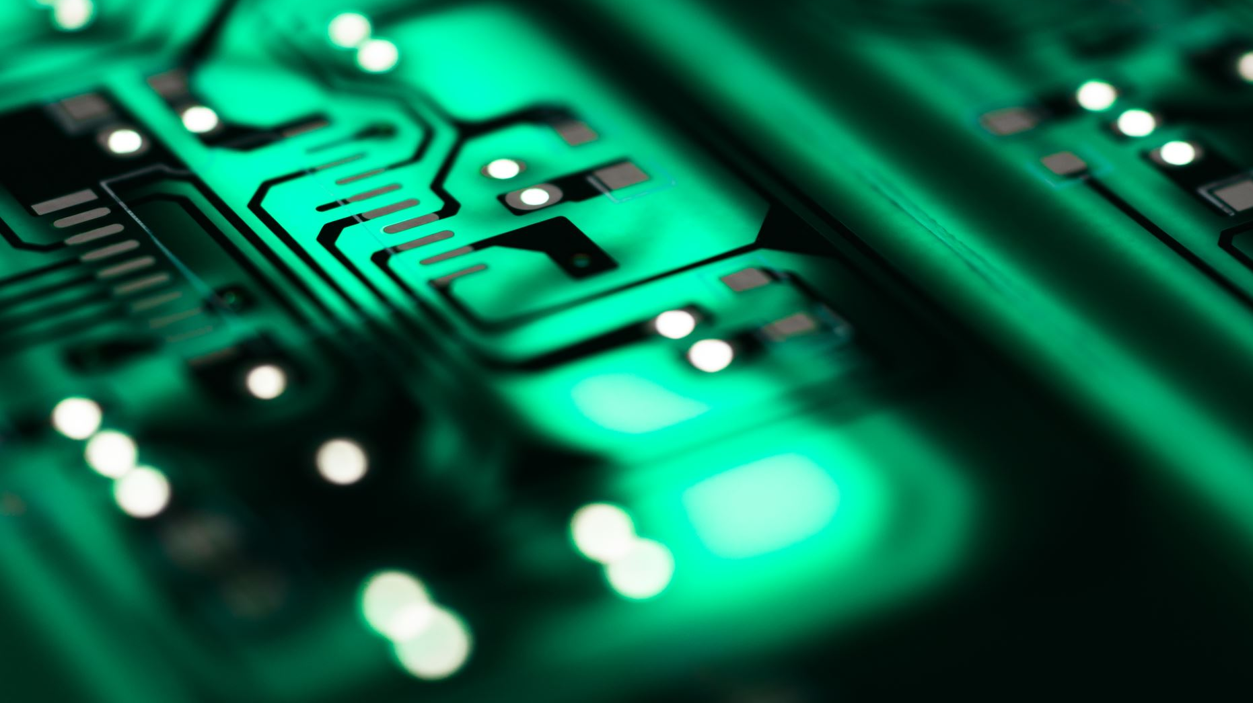
Arabic → English Neural Machine Translation
Fine‑tuning Helsinki-NLP OPUS‑MT on OPUS100 (ar‑en)

Slide 2

Motivation & Objectives:

Slide 3
Why MT?
Bridge language barriers
Enable information access for Arabic speakers
Project Goals
Fine-tune a pretrained model for Arabic→English
Leverage the OPUS100 parallel corpus
Deploy as a desktop translator app

Slide 4
Pretrained Model Overview

Slide 5
Pretrained Model – OPUS-MT
Model: Helsinki-NLP OPUS-MT
Architecture: Marian (Transformer-based)
Pretraining Data: Massive, multilingual parallel corpora (news, subtitles, web crawls…)
Key Strengths:
Fast inference suited for real-time applications
Open-source under MIT license, easy integration via Hugging Face
Broad language coverage – over 100 language pairs

Slide 6
Helsinki‑NLP/opus‑mt‑ar‑en Model Parameters
Encoder layers: 6
Decoder layers: 6
Hidden size (d_model): 512
Feed‑forward size (FFN dim): 2048
Attention heads: 8
Vocabulary size: 62,834
Total parameters: ~77 million

Slide 7

Dataset – OPUS100 ar-en

Slide 8
The dataset
Source: OPUS100 (“Open Parallel Corpus”)
Language Pair: Arabic ↔ English
Splits:
Train: ~1 million sentence pairs
Validation: ~2 000 sentence pairs
Characteristics:
Diverse domains (news, subtitles, books)
Mixed formal/informal registers

Slide 9
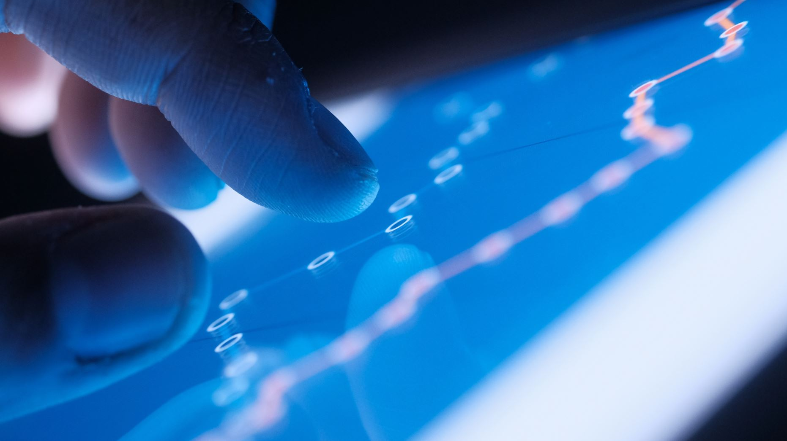
Data Preprocessing

Slide 10
Data Preprocessing
Tokenization with SentencePiece
Fixed vocabulary, subword units
Max Sequence Lengths: 128 tokens (source & target)
Padding & Truncation:
Uniform batch shapes
Batching:
Train/eval batch size = 16

Slide 11

Training Setup

Slide 12
Training Setup
Trainer Framework:
Hugging Face Transformers – Seq2SeqTrainer
Hyperparameters:
Epochs: 2
LR: 5 × 10⁻⁵
Weight decay: 0.01
Beam search: beam size = 5
Mixed-precision (fp16) on GPU
Strategies:
Eval & checkpoint at every epoch
Load best model by BLEU score

Slide 13

Evaluation Metrics

Slide 14
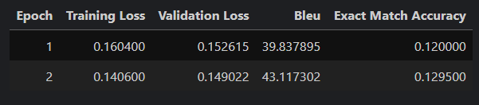
Evaluation Metrics
BLEU (sacrebleu): measures n-gram match
Exact-Match Accuracy: percentage of entirely correct sentences
Results (example):
BLEU ≈ 43.11
Exact-Match ≈ 0.129 %

Slide 15
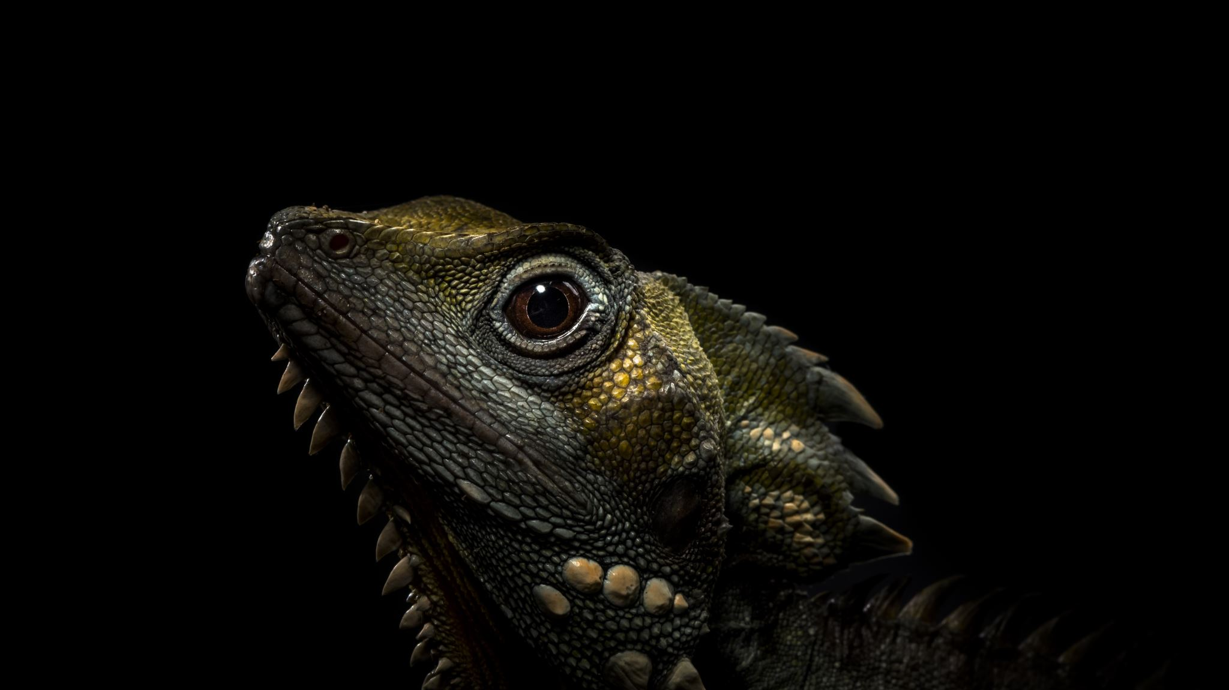
Demo – Desktop GUI

Slide 16
Demo – Desktop GUI
Framework:
Tkinter (Python standard library)
Layout:
Input Box: Scrolled text widget for Arabic input
Output Box: Read-only scrolled text widget for English translation
Controls:
Translate button: invokes model inference
Clear button: resets both text boxes
Purpose:
Visualize the complete pipeline—from text entry through tokenization, model generation,and decoding—in a user-friendly desktop app

Slide 17

Save & Deploy

Slide 18
Save & Deploy (Tkinter Edition)
Save Artifacts:
trainer.save_model("path/to/model")
tokenizer.save_pretrained("path/to/model")
Load in Tkinter App:
AutoTokenizer.from_pretrained("path/to/model")
AutoModelForSeq2SeqLM.from_pretrained("path/to/model")

Slide 19

Conclusions & Future Work

Slide 20
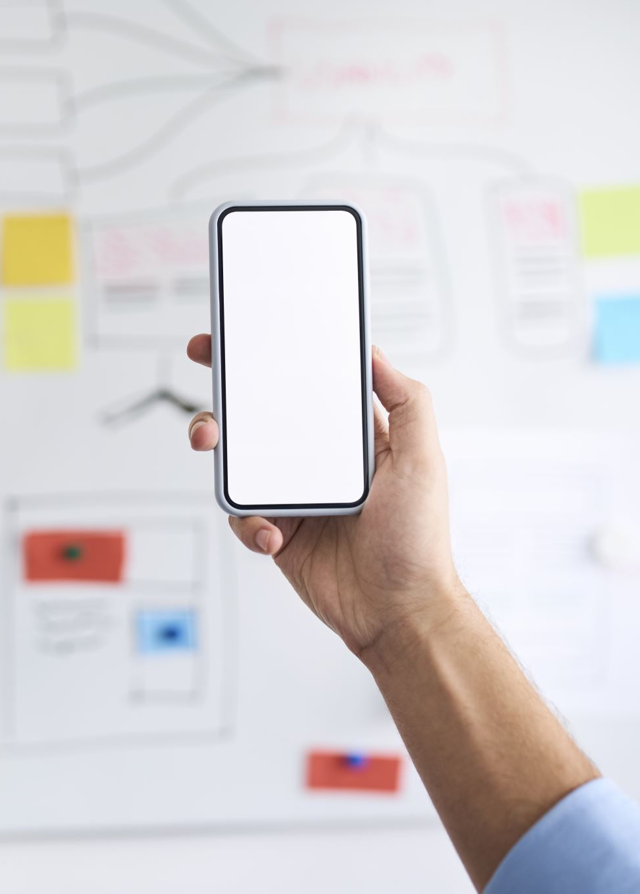
Conclusions & Future Work
Achievements:
Improved translation quality over baseline
Fast, user-friendly GUI
Next Steps:
Train longer / more epochs
Experiment with larger architectures (mBART, M2M)
Add support for additional domains & dialects
Web/mobile app integration

Slide 21

Q&A

Slide 22
Thank you!
Questions?

